Slide 1

Statistical Analysis
With Stata
Chinazom Jennifer Okoli

Slide 2
Table of Content
Learning Objectives
Statistical Analysis
Overview
Types
Key concepts
Common statistical tests
Process
Applications
Tools and Software
Stata
Introduction to Stata
Why Stata
Navigating the Interface
Basic Commands and Functions
Data Analysis Workflow in Stata

Slide 3
Learning Objectives
Gain a solid understanding of statistical analysis, its types, key concepts, common tests, and applications.
1
Develop proficiency in using Stata for data entry, management, analysis, and visualization.
2
Learn to navigate Stata's interface, utilize basic commands, and apply statistical methods effectively in various contexts.
3
Appreciate real life application
4

Slide 4
Statistical Analysis
The process of collecting, examining, interpreting, and presenting data to uncover patterns, trends, and relationships within a dataset.
It is a subset of data analysis that specifically involves the application of statistical methods and theories to understand data, identify relationships, and draw inferences.

Slide 5
Types of Statistical Analysis
Descriptive Statistics: Summarizes and describes the features of a dataset.
Techniques:
Measures of Central Tendency
Measures of Dispersion
Frequency Distributions
Graphical Representations
Notes:
Descriptive statistics involves summarizing and describing the main features of a dataset. This includes measures such as the mean, median, mode, standard deviation, and various graphical representations like histograms and bar charts. The goal is to provide a clear and concise overview of the data without making predictions or generalizations beyond the dataset.
Techniques:
Measures of Central Tendency: Mean, median, mode.
Measures of Dispersion: Range, variance, standard deviation.
Frequency Distributions: Tables and charts showing how often each value occurs.
Graphical Representations: Histograms, bar charts, pie charts, box plots.
Common measures include:
Mean: The average of the data.
Median: The middle value when the data is ordered.
Mode: The most frequently occurring value.
Range: The difference between the highest and lowest values.
Standard Deviation: Measures the spread of data around the mean.
Variance: The square of the standard deviation, indicating data dispersion

Slide 6
Inferential statistics: making conclusions about a population based on a sample.
Common techniques include:
Hypothesis Testing
Confidence Intervals
Regression Analysis
Correlation Analysis.
Notes:
Common techniques include:
Hypothesis Testing: Determines if there is enough evidence to reject a null hypothesis.
Confidence Intervals: Provides a range of values within which a population parameter is likely to fall.
Regression Analysis: Examines relationships between variables.
ANOVA (Analysis of Variance): Compares means among three or more groups.

Slide 7
Key Concepts in Statistical Analysis
Population
Sample
Probability
Distributions
P-value
Correlation vs. Causation
Variables
Notes:
Key Concepts in Statistical Analysis
Population vs. Sample:
Population: The entire group of interest.
Sample: A subset of the population used to make inferences about the entire population.
Probability: Measures the likelihood of an event occurring. It's fundamental in inferential statistics, particularly in hypothesis testing and predictive modeling.
Distributions:
Normal Distribution: A symmetrical, bell-shaped distribution where most values cluster around the mean.
Binomial Distribution: For discrete data, it represents the number of successes in a fixed number of trials.
Poisson Distribution: Models the probability of a given number of events occurring in a fixed interval.
P-value: A probability that measures the strength of evidence against the null hypothesis. A smaller p-value indicates stronger evidence to reject the null hypothesis.
Correlation vs. Causation:
Correlation: Measures the strength and direction of the relationship between two variables.
Causation: Indicates that one event causes another.

Slide 8
Variables
Variables are the elements we measure, manipulate, or observe in a study.
Classification are based on;
Role in analysis: Dependent and Independent
Characteristics: Categorical and Numerical

Slide 9
Independent Variables:
Variables that are manipulated or categorized to observe their effect on other variables.
Examples: Study time, treatment type.
Dependent Variables:
The outcome or response variable that is measured to see how it is affected by the independent variables.
Examples: Test score, health outcome.

Slide 10
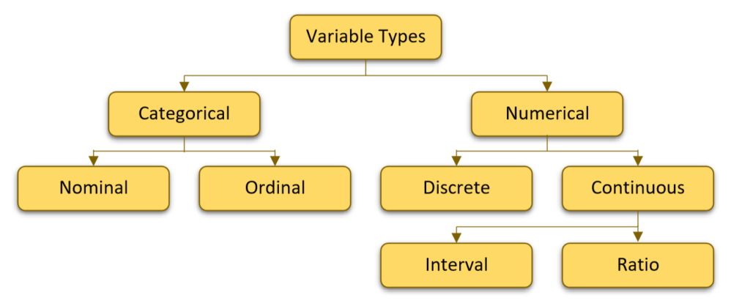
Notes:
Numerical (Quantitative) Variables:
Variables that represent numerical values and can be measured.
Types:
Discrete Variables: Countable values, often integers (e.g., number of students, number of cars).
Continuous Variables: Values that can take on any value within a range, often measured (e.g., height, weight, temperature).
Interval variables are numeric variables where the difference between values is meaningful and consistent, but there is no true zero point that represents the absence of the quantity.
Characteristics:
Equal Intervals: The differences between values are consistent across the range of the variable. For instance, the difference between 10°C and 20°C is the same as the difference between 30°C and 40°C.
No True Zero: There is no point where the variable indicates a complete absence of the quantity. For example, 0°C does not mean there is no temperature; it's just a point on the temperature scale.
Examples:
Temperature (Celsius or Fahrenheit): The interval between degrees is the same, but 0°C or 0°F does not imply the absence of temperature. It simply denotes a specific point on the temperature scale.
Ratio variables are numeric variables with equal intervals between values and a true zero point, which signifies the complete absence of the quantity being measured. This allows for meaningful comparisons of ratios.
Characteristics:
Equal Intervals: Like interval variables, the differences between values are consistent.
True Zero: There is a point where the variable indicates the complete absence of the quantity. For example, 0 height means no height, and 0 weight means no weight.
Examples:
Height: If someone is 0 cm tall, they have no height. Differences in height (e.g., the difference between 150 cm and 160 cm) are consistent and meaningful.
Weight: A weight of 0 kg means no weight. A person weighing 80 kg is twice as heavy as someone weighing 40 kg.
Categorical (Qualitative) Variables:
Variables that represent categories or groups and are not numerical.
Types:
Nominal Variables: Categories without a specific order (e.g., gender, colour, , marital status).
Ordinal Variables: Categories with a meaningful order but not necessarily equal intervals (e.g., satisfaction ratings, education level).

Slide 11
Common statistical tests
Chi-Square Test: Tests the association between categorical variables.
T-Test: Compares the means of two groups
Independent Samples T-Test
Paired Samples T-Test
ANOVA (Analysis of Variance): Compares means among three or more groups
One-Way ANOVA
Two-Way ANOVA
Independence
Goodness of Fit
Notes:
1. T-Test
- Purpose: Compares the means of two groups to determine if they are significantly different.
- Types:
- Independent Samples T-Test: Compares means of two separate groups.
- Paired Samples T-Test: Compares means from the same group at two different times or conditions.
2. ANOVA (Analysis of Variance)
- Purpose: Compares means among three or more groups to identify if there are any significant differences.
- Types:
- One-Way ANOVA: Compares means across multiple independent groups based on one factor.
- Two-Way ANOVA: Examines the effects of two factors and their interaction on the dependent variable.
3. Chi-Square Test
- Purpose: Tests the association between categorical variables.
- Types:
- Chi-Square Test of Independence: Assesses if two categorical variables are independent.
- Chi-Square Test of Goodness of Fit: Checks if observed frequencies match expected frequencies.

Slide 12
Correlation Analysis: Measures the strength and direction of the linear relationship between two quantitative variables.
Pearson Correlation Coefficient (r)
Regression Analysis: Examines the relationship between a dependent variable and one or more independent variables.
Spearman Rank Correlation Coefficient
Simple Linear Regression
Multiple Regression
Notes:
4. Correlation Analysis
Purpose: Measures the strength and direction of the linear relationship between two quantitative variables.
Types
- Pearson Correlation Coefficient (r): Measures linear correlation (range: -1 to 1).
- Spearman Rank Correlation Coefficient: Measures association between ranked variables.
5. Regression Analysis
- Purpose: Examines the relationship between a dependent variable and one or more independent variables.
- Types:
- Simple Linear Regression: Models relationship between one dependent variable and one independent variable.
- Multiple Regression: Models relationship between one dependent variable and multiple independent variables.

Slide 13
Statistical Analysis Process
1. Define the Research Question or Hypothesis
2. Collect Data
3. Prepare the Data
4. Explore the Data
5. Choose the Appropriate Statistical Test
6. Perform the Statistical Analysis
7. Interpret the Results
8. Report the Findings
9. Validate the Results
10. Make Decisions or Take Action
Notes:
The statistical analysis process involves several systematic steps to collect, analyze, and interpret data to make informed decisions.
1. Define the Research Question or Hypothesis
- Identify the Problem: Clearly define the problem or research question you want to address.
- Formulate Hypotheses: Develop a null hypothesis (H₀) and an alternative hypothesis (H₁) if applicable.
2. Collect Data
- Determine Data Requirements: Identify the type of data needed (quantitative or qualitative) and how it will be collected (surveys, experiments, etc.).
- Sampling: Decide on the sampling method (random, stratified, etc.) and sample size to ensure representativeness.
3. Prepare the Data
- Data Cleaning: Check for missing values, outliers, or errors and address them appropriately.
- Data Transformation: Convert data into the required format, such as coding categorical variables or normalizing data.
4. Explore the Data
- Descriptive Statistics: Calculate measures of central tendency (mean, median, mode) and variability (range, standard deviation).
- Data Visualization: Use charts, graphs, and plots to visualize patterns, trends, and distributions in the data.
5. Choose the Appropriate Statistical Test
- Determine Test Type: Select the statistical test based on the research question, type of data, and data distribution (e.g., t-test, ANOVA, chi-square test).
6. Perform the Statistical Analysis
- Conduct the Test: Run the chosen statistical test using appropriate software.
- Calculate Test Statistics: Obtain test statistics (e.g., t-value, F-value) and corresponding p-values.
7. Interpret the Results
- Assess Significance: Compare the p-value to the significance level (α) to determine if the results are statistically significant.
- Draw Conclusions: Based on the results, decide whether to reject or fail to reject the null hypothesis.
- Consider Practical Significance: Evaluate the effect size or practical implications of the findings.
8. Report the Findings
- Document the Analysis: Clearly report the methods, results, and interpretations.
- Visualize Results: Use tables, charts, and graphs to present the findings in an understandable manner.
- Make Recommendations: Provide insights or recommendations based on the analysis.
9. Validate the Results
- Cross-Validation: Use techniques such as splitting the data or using multiple models to validate the results.
- Sensitivity Analysis: Test how sensitive the results are to changes in assumptions or input data.
10. Make Decisions or Take Action
- Implement Findings: Use the insights from the analysis to make informed decisions or policy changes.
- Monitor Outcomes: Continuously monitor the outcomes to assess the impact of the decisions made.
The statistical analysis process is iterative, and sometimes you may need to revisit earlier steps based on what you learn as the analysis progresses.

Slide 14
Applications
Business and Finance
Healthcare
Education
Social Sciences
Sports
Environmental Science
Government and Public Policy
Manufacturing
Agriculture
Notes:
Business and Finance: Making decisions on marketing, investments, and improving product quality.
Healthcare: Testing new treatments, studying diseases, and managing patient data.
Education: Analysing student performance, creating tests, and shaping educational policies.
Social Sciences: Understanding human behaviour, opinions, and social trends.
Sports: Improving player performance, preventing injuries, and engaging fans.

Slide 15
Tools and Software
Excel
R
Python
SPSS (Statistical Package for the Social Sciences)
SAS (Statistical Analysis System)
Stata
MATLAB
and so on...

Slide 16
Stata
Overview: A general-purpose statistical software package for data manipulation, visualization, statistics, and automated reporting.
Usage: by researchers in many fields; biomedicine, economics, epidemiology, and sociology
History: Developed by StataCorp, and has evolved since its introduction in 1985
Versions: Stata/MP (for multicore processing), Stata/SE (Standard Edition), and Stata/IC (Intercooled, for smaller datasets)

Slide 17
Why Stata
Flexible Interface: Combination of GUI and Command-Line Interface
Comprehensive and Integrated Environment: All-in-One Solution
Versatility
User Community
Efficiency
Reproducibility
Notes:
Why Stata
Versatility: Stata is versatile, supporting a wide range of statistical techniques from basic descriptive statistics to advanced econometrics and survival analysis.
User Community: Stata has a strong user community that contributes to a large repository of user-written commands and support forums, making it easier for users to find help and share knowledge.
Efficiency: Stata is designed to handle large datasets efficiently and is optimized for both speed and accuracy, making it suitable for large-scale data analysis projects.
Reproducibility: Stata emphasizes reproducibility in research by allowing users to save their work in do-files, log-files, and scripts that can be easily shared and replicated by others.

Slide 18
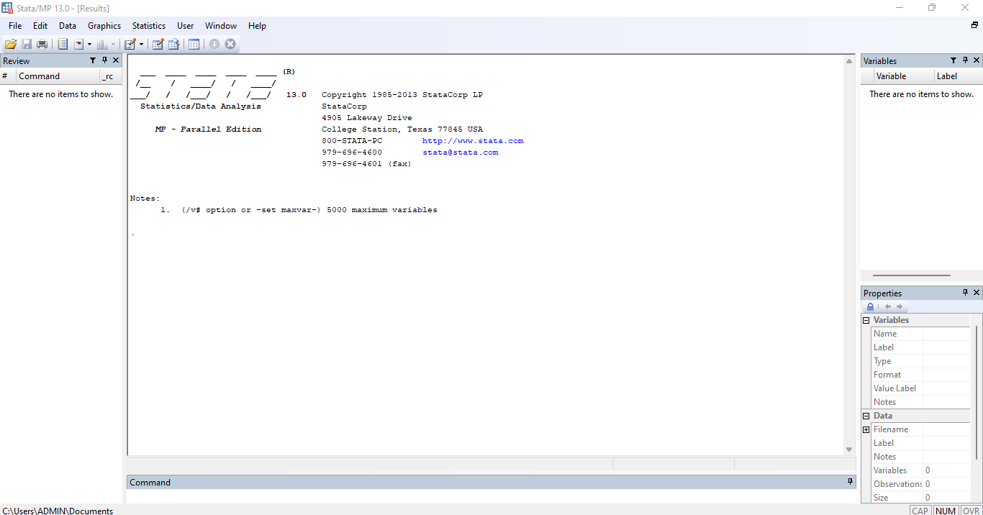
Navigating the Interface
Notes:
Tabs:
Title Bar: Displays the name of the currently open dataset and the version of Stata you are using.
Menus: Drop-down menus at the top of the window (File, Edit, Data, Graphics, Statistics, etc.) provide access to Stata’s functions and commands.
Toolbars: Quick access icons for frequently used commands such as opening a dataset, saving, running
Command Window: Where you type and run Stata commands.
Results Window: Displays the output of your commands.
Variables Window: Lists the variables in your dataset.
Properties Windows: Shows details of your variables
Review Window: Keeps a history of the commands you've entered. do-files, and more.

Slide 19
Basic Commands and Functions
Data Management:
use
import
save
rename
label variable
drop
sort
Notes:
Data Management:
use: Load a dataset.
Import: Import data from external formats like Excel or CSV.
save: Save the current dataset.
rename: Change variable names.
label variable: Add or modify labels for variables.
drop: Remove variables or observations.
sort: Sort data by one or more variables.
Entering Data:
Data can be entered manually using the Data Editor or imported from various sources like CSV files, Excel files, and databases.
Data Editor: Offers a spreadsheet-like interface to enter and edit data directly.
Command Entry: Commands like input or insheet can be used to input data directly through the Command Window or scripts.
Managing Data:
Variable Transformation: Use commands like generate to create new variables or replace to modify existing ones.
Merging Datasets: Combine datasets using merge or append new observations with append.
Cleaning Data: Detect and handle missing values with commands like misstable, and filter observations using keep and drop.

Slide 20
Statistical Analysis:
summarize
tabulate
regress
ttest
Anova
Data Visualization:
•graph bar
•graph pie
•Scatter
•histogram
Notes:
Statistical Analysis:
summarize: Provide summary statistics for variables.
tabulate: Generate frequency tables for categorical variables.
regress: Perform linear regression analysis.
ttest: Conduct t-tests to compare means.
anova: Perform analysis of variance.
Data Visualization:
graph bar: Create bar charts.
graph pie: Create pie charts.
scatter: Create scatter plots.
histogram: Plot histograms

Slide 21
Data Analysis Workflow in Stata
1. Data Entry
2. Data Wrangling
3. Statistical Analysis
4. Data Visualization
5. Reporting
6. Communication
Notes:
Data Analysis in Stata
1.Data Entry:
- Importing Data: Bring data into Stata from various formats such as Excel, CSV, or databases using commands like `import` or `use`.
- Manual Data Entry: Use the Data Editor to input data directly into Stata's spreadsheet-like interface.
- Data Integrity Checks: Verify data accuracy and consistency during the entry process.
2. Data Wrangling:
- Data Cleaning: Identify and handle missing data, outliers, and inconsistencies using commands like `misstable`, `replace`, and `drop`.
- Data Transformation: Create new variables, recode values, and modify existing variables with commands like `generate`, `replace`, and `recode`.
- Data Integration: Combine multiple datasets through merging (`merge`) or appending (`append`).
3. Statistical Analysis:
- Descriptive Statistics: Summarize data with measures such as mean, median, standard deviation using `summarize`, and explore distributions with `tabulate`.
- Inferential Statistics: Conduct hypothesis tests, regression analysis, and other statistical tests using commands like `ttest`, `regress`, and `anova`.
- Advanced Modeling: Implement complex models such as logistic regression (`logit`), time series analysis, and survival analysis.
4. Data Visualization:
- Creating Graphs: Generate visual representations of data, such as histograms (`histogram`), scatter plots (`scatter`), and bar charts (`graph bar`).
- Customizing Visuals: Enhance graphs with options for colors, labels, legends, and layouts to improve clarity and impact.
- Exporting Graphs: Save visualizations in formats like PNG, PDF, or SVG for use in reports and presentations.
5. Reporting:
- Generating Output: Use Stata's log files to document commands and results, ensuring reproducibility and transparency.
- Formatting Results: Customize output tables, graphs, and statistics for inclusion in formal reports or publications.
6. Communication:
- Sharing Findings: Export data, results, and visualizations for sharing with collaborators or stakeholders.
- Reproducible Research: Use do-files to script entire analyses, ensuring that others can replicate the work.
- Collaboration: Utilize Stata's documentation and commenting features to communicate analysis decisions and methods within teams.

Slide 22
Data Types
Data types define how data is stored in variables.
Numeric Types
byte
int
long
float
double.
String Types
str#
Notes:
Data Types in Stata
In Stata, data types define how data is stored in variables. Understanding these types is crucial for effective data management and analysis.
Numeric Types
byte: Stores integers from -127 to 100. Example: Age groups (1, 2, 3).
int: Stores larger integers from -32,767 to 32,740. Example: Number of items sold.
long: Stores even larger integers from -2.1 billion to 2.1 billion. Example: Large populations.
float: Stores single-precision floating-point numbers (decimal values). Example: Prices like 19.99.
double: Stores double-precision floating-point numbers, offering higher precision. Example: Scientific measurements like 3.1415926535.
String Types
str# (where # is the length of the string): Stores textual data, with the length defined by the number (#). Example: str20 can store a name up to 20 characters long.

Slide 23
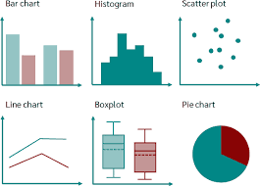
Chart types
Notes:
Bar Chart: Compares categorical data or groups.
Histogram: Shows the distribution of continuous data.
Scatter Plot: Examines relationships between two continuous variables.
Line Chart: Displays trends over time or continuous variables.
Box Plot: Summarizes data distribution and identifies outliers.
Pie Chart: Represents proportions of a whole.

Slide 24



